Slide 1
Modelling of modern China economy from an information entropy perspective
Author：Yan Jun
22th, September,2022

Slide 2
Content
The History of Entropy
Method of Information Entropy
Data Base and Modelling
Result
Conclusion

Slide 3
What is entropy
exergy
energy
entropy

Slide 4
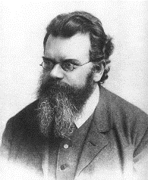
Entropy and economics
Sadi Carnot
(1796–1832) heat engine
Ludwig Boltzmann (1844–1906)
E. T. Jaynes (1922–1998)
The history of entropy research
Rudolf Clausius (1822–1888)-defined entropy
Nicholas Georgescu-Roegen
Claude Shannon (1916–2001)

Slide 5
Victor Yakovenko
Professor of Physics at the University
Explains the analogy between thermal and economic system
Creatively introduced the entropy increase principle in the economic field
Explained that money is also a similar amount of energy conservation. In a closed economy in monetary system under equilibrium obey Boltzmann distribution,
Useed computer simulation explains the inhomogeneity of the wealth distribution, the disparity between the rich and the poor like a natural phenomenon in the world
Wealth distribution obey the pareto principle of 20% of people enjoy 80% of the wealth and resources

Slide 6
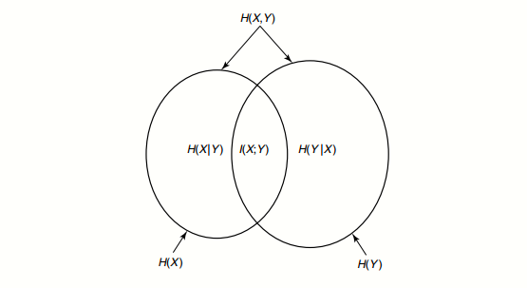
Methodology: Information Entropy
I(X；Y)= I(Y；X)
I(X；Y)= H(Y)- H(Y/X)
H(X,Y) = H(X)+ H(Y/X)
I(X；Y)= H(X)+ H(Y) - H(X,Y)
Conditional Entropy
Joint Entropy
Mutual information
Information theory and entropy

Slide 7
Methodology:Entropic Index Formulation
From statistical physics and computer science to economics
micstate
Sum of number
Multiplicity of State h
Multinomial coefficient
Entropy of state h
f is a dimensionless scaling factor. If f=1,
Maximum entropy
$$s(h) = \log_{K}\left(Ω\left(h\right)\right)$$
Super state space, configuration space

Slide 8
Result: National level
Open system Closed system
Why?

Slide 9
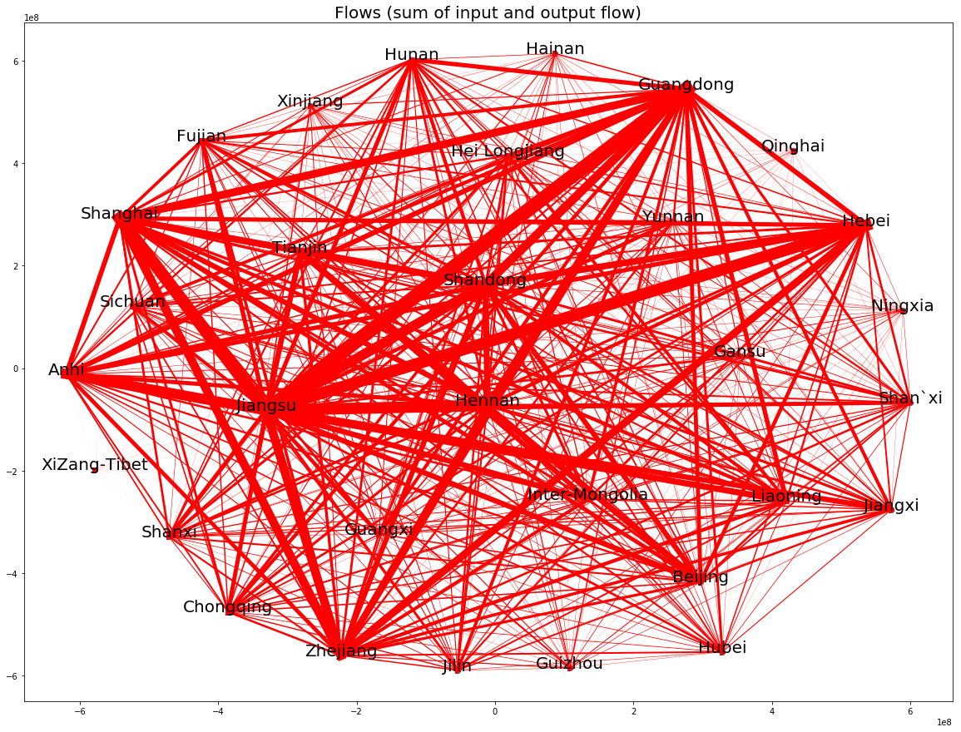
Result: Province level

Slide 10
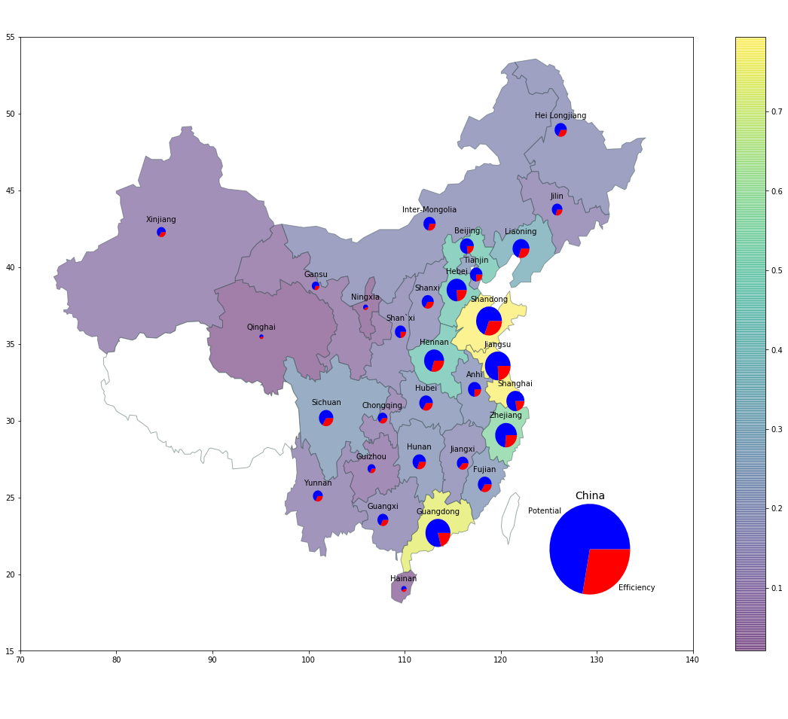
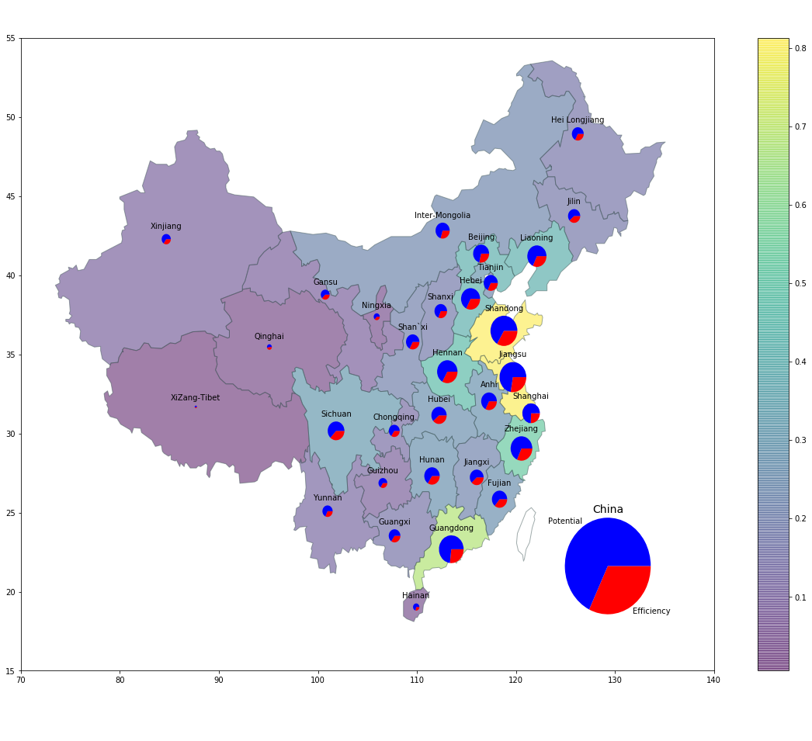
Result: Province level

Slide 11
Conclusion
After the financial crisis in 2008, the global economy faced a downward trend, but China's economic development entered a new normal, maintaining a medium-low growth rate.
China's economic growth is highly resilient, providing ample room to meet external challenges to achieve high-quality development.
China’s regional development in 2007 and 2012 has been unequal between the provinces. From the modelling, authors rank China’s provincial development, and find that Shandong province had the highest potential economic growth.

Slide 12
New economics: Biophysical economics

Slide 13
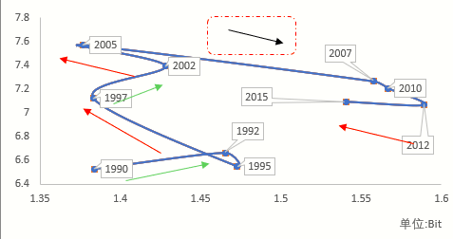
Which are good indicators for economy?
 | 1992 | 1997 | 2002 | 2007 | 2012
Energy expenditure | 12.58% | 14.37% | 13.69% | 21.69% | 12.94%
GDP growth per year | 9% | 11% | 8% | 12% | 9%
EROI of country level (Net power rate) | 9 | 7.7 | 5 | 6.4 | 5
Information entropy

Slide 14
Thank you!
谢谢！
闫君
yanjun2014@126.com

