Slide 1
Modelling and Simulation of Social Behavioural Phenomena in Creative Societies
Prof. habil. dr. Leonidas Sakalauskas
Vilnius Gediminas Technical University, Lithuania

Slide 2
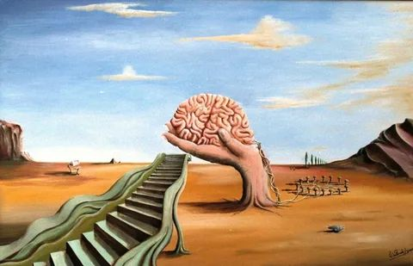
Content
Introduction
Modelling of structural equations
Game theory models
Multi-agent models in mathematical sociology
Evidence-based solutions and policies
Logical-verbal and other intelligence
Wrap=up and conclusions

Slide 3
Introduction

Slide 4
Relevance
The origins of the study into modern global development have been in the projects of the Roman Club since 1970.
The main conclusion was that if current trends in civilization expansion remain unchanged, then there will be a global crisis facing the world around 2060.
A peak point was reached in 2015, after which the situation most probably could only get worse. The real data confirm the progress of the Roman club's predictions. In this way, predicting global development is a very global problem, which has recently begun to be described as “reset” (many researchers and research centers stress that a fundamental rethink, reorganisation, etc., of development processes is now needed, which is what is called „reset“).

Slide 5
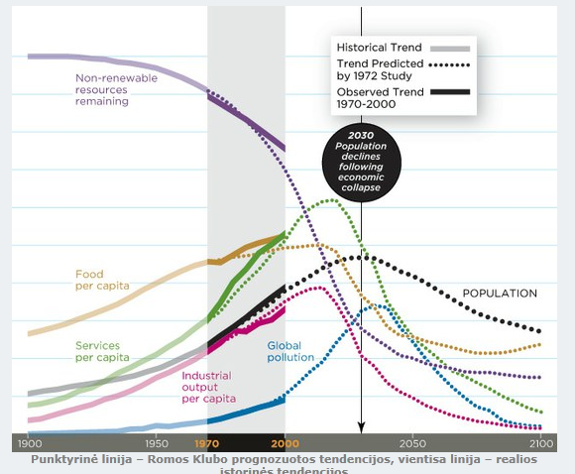
Relevance
The results of a recent comparison between predictive assumptions and real statistics by Australian physicist Graham Turner show that the Roman Club's predictions are coming true, according to Smithsonian Magazine at the Massachusetts University of Technology (MIT). MIT warns: the world is on the road to death.

Slide 6
Introduction
The growing challenges of societal sustainability, social complexity, behavioral operations research, and cohesion are becoming more and more acknowledged worldwide.
However, there is a conceptual and analytical gap in understanding the driving forces behind it.

Slide 7
Introduction
Thorough multidisciplinary research efforts are in demand, starting from concepts, models, and ending with recommendation and decision support systems
It is natural to assume that in the current historical time, when many delicate socio-political challenges have to be dealt with once again, it is important to resort to OR to overcome those challenges.
In this regard, simple and universally acceptable assumptions behind OR need to be formulated addressing the complex social-behavioural phenomena of today.

Slide 8
Purpose
To review the mathematical-computational OR methodology of modelling social-behavioural phenomena, based on:
links between the theory of communication action and the ontologies of informatics and mathematics;
methods of modelling structural equations, gaming theory and multi-agent modelling.

Slide 9
Social Behavioural Phenomena
Society creates a set of social behavioural phenomena:
The conduct of voters during elections;
The behaviour of the crowd in a terrorist attack;
Social processes during pandemics;
Faculty social capital development processes;
Behaviour of social network users;
...,
whose knowledge of mechanisms is essential for building a sustainable society, in order to develop a paradigm of rational choice for the efficient understanding of their essence and relevant decision-making, thus bridging OR and computer science with social sciences and humanities.

Slide 10
Social Behavioural Phenomena
The creation of such a paradigm on the theoretical basis of
structural equation modelling,
multi-agent modelling,
game theory,
together with data science and mathematical sociology methods, allows the development of data-driven operationalisation for evidence-based solutions and policies.

Slide 11
The Theory of Communicative Action
The fundamental elements of the existence of humans are language and action.
The development and interaction of these elements can be explored from the point of view of communicative action and rational choice theories.

Slide 12
The Theory of Communicative Action
People act in accordance with other people's actions and therefore need effective communication based on equal understanding and rationality.
J. Habermas (1984) defines the communicative action as “the interaction between at least two entities that can speak and act with each other by using verbal or non-verbal means.”

Slide 13
Operationalism and Operationalisation
Operationalism is based on the assumption that the elements of reality can and must be defined by reference to the rules of direct or indirect measurement of that element.
The term was first used by P. W. Bridgman in “The Logic of Modern Physics” (1927).
These ideas have given impetus to J. Habermas' theory.

Slide 14
Operationalism and Operationalisation
P. W. Bridgman insisted that all scientific concepts be described on the basis of measuring procedures and thinking operations and manipulation of symbols.
The concept which is not directly or indirectly linked to any measurement procedure is meaningless.

Slide 15
Operationalism and Operationalisation
Measurement can also be understood in a broader sense: this may include not only the results of monitoring devices or sensors, but also the information provided by public surveys or various statistical sources, etc.
This point-of-view makes it possible to develop a methodology for exploring complex social and humanitarian processes and phenomena, using mathematical and computer science models.

Slide 16
Operationalism and Operationalisation
Consensus on thinking operations and symbolism manipulation can be achieved by applying ontologies to specify the concepts of the area in question.
The first definition of ontology in the field of artificial intelligence was given by Gruber (1993): “ontology is the specification in expressed form of a body of concepts in a particular field.”

Slide 17
Operationalism and Operationalisation
Operationalisation is a process for the introduction, monitoring and measurement of quantitative indicators with a view to exploring theoretical concepts.
Theoretical concepts are cognitive blocks created by distinguishing between the main characteristics of the objects in question and the secondary parts.

Slide 18
Limitations
Operationalization through ontologies inevitably leads to limitations relating to
the finite completeness of this process,
the internal organization of ontologies, -
the possible non-existence of solutions to the problems being solved, etc.

Slide 19
Structural equation modelling

Slide 20
Structural Equation Modelling
Structural equation modelling (SEM) can be used as a means of operationalisation and decision-making, as it includes a variety of mathematical model sets, computer algorithms and statistical methods to study data constructions.

Slide 21
Structural Equation Modelling
SEM uses a measurement model that defines latent (hidden) variables related to one or more observed variables and a structural model that models relationships between latent variables.
The relationship between observable and hidden data and structural equations is assessed by statistical methods.
SEM combines regression and factorial analyses. It shall also include investigating and confirmatory factorial analyses.

Slide 22
Game Theory Models

Slide 23
Game Theory
Game Theory encompasses a wide range of decision-making tasks, such as gambling, where the outcome of choices of alternatives/solutions is influenced by the actions of other individuals.
Game Theory investigates strategic decision-making by developing mathematical models for conflicts and cooperation between rational entities.
The main object of the game theory is to examine the conditions of equilibrium (equilibrium) in the light of the strategy used by each entity.

Slide 24
Group Decisions
Group decision-making tasks typically address a set of alternatives in which individuals may have different preferences (priority lists).
It is therefore necessary, under a rule (law, constitution, voting procedure, etc.), to select a set of preferences for the whole group, i.e. a decision taken by the whole group.

Slide 25
Arrow’s Paradox
K. Arrow tried to create a way to correctly summarise personal preferences, i.e. to create a fair electoral system.
But he only succeeded in formulating and proving the theorem that this was impossible.
This theorem is sometimes called a theorem about the impossibility of democracy.

Slide 26
Arrow’s Paradox
Arrow demanded that some fairly meaningful assumptions (axioms) be fulfilled.
Universality. Each voter shall submit one and only one alternative priority list, which he shall draw up at his own discretion.
Consensus. If all individuals give a higher priority to some choice than to some other, then the first will be more popular in the overall rankings as well.
The absence of a dictator. The final priority list shall take into account all opinions. This list cannot be compiled by just one individual who would impose it on everyone.
Independence from extraneous alternatives. If voters have found that А is above В, then А must stay above В on this list, regardless of whether other alternatives may have been inserted, removed or altered.

Slide 27
Arrow’s Paradox
Arrow's theorem concludes that there is no way of harmonising the priority lists satisfying all the assumptions of universality (I), consensus (II), absence of dictator (III), and independence from extraneous alternatives (IV).
Thus, a common list that would allow a group decision would have to violate at least one assumption, such as allowing decisions to be made by a dictator.

Slide 28
Economical Application of Arrow‘s Theorem
Let John (J), Peter (P) and Anthony (A) make a deal and get an order that can be made by three or two. Order price is 100 EUR. There are no job orders for one employee at a time.
In this game, the “fairest” transaction calculated using the Shepli method is to include all three in the transaction and divide earnings equally: S = (33,33; 33,33; 33,33).
It should be noted that the division in this game is unstable. In fact, there is nothing to prevent John from agreeing with Peter and leaving Anthony nothing: S = (50; 50; 0). Anthony, however, can then offer to take part in the deal to John, agreeing that he would get more: S = (60; 0; 40), etc.
If we have a society whose basic needs of the Maslow pyramid are met only by a certain part of the society‘s workforce, the inclusion of the rest of society in the realization of the higher needs of the Maslow pyramid becomes a pressing problem.

Slide 29
Multi-Agent Models in Mathematical Sociology

Slide 30
Multi-Agent Models in Mathematical Sociology
Mathematical sociology seeks to express the patterns of social theories through mathematical concepts.
It was started by modelling large social (non-virtual) networks using relational algebra and probability models.

Slide 31
Multi-Agent Models in Mathematical Sociology
In the book “Introduction to Mathematical Sociology”, J. S. Coleman showed how stochastic processes on social networks can be analysed for testing models developed using appropriate data.

Slide 32
Multi-Agent Models in Mathematical Sociology
Robert Axelrod has developed a multi-agent computer model in which agents interact with each other to solve the prisoner's dilemma.
He invited colleagues from around the world to compete in developing computer programs to find and describe the best strategies.
The programs included in the competition varied in algorithmic complexity, initial attitude of agents, ability to complete interaction, etc.
The results are described in The Evolution of Cooperation (1984).

Slide 33
Multi-Agent Models in Mathematical Sociology
Axelrod discovered that if gaming had been repeated for a long time among many gamers, each with different strategies, “greedy” strategies had eventually yielded bad results when more “altruistic” strategies were in place.
He used this result to show a possible mechanism for the evolution of altruistic behavior by natural selection from mechanisms that were originally purely egotistical.

Slide 34
Multi-Agent Models in Mathematical Sociology
The best deterministic strategy was the “Tit for tat” developed and presented at the championship by Anatoly Rapoport.
It was the simplest of all the programs that took part, consisting of only 4 code lines in BASIC.
The strategy is simple: to collaborate in the first repetition of the game, after which the player does the same as the opponent did in the previous step.

Slide 35
Characteristics of Successful Strategies
The strategy has to be “good,” that is, not to betray until the opponent has done so. Almost all the leaders were good. Therefore, a purely selfish strategy should not be the first to attack a rival for purely egoistic reasons.
Revenge. The strategy must not be based on blind optimism. It has to always avenge. An example of an unadvisable strategy is always to cooperate. It's a very bad choice because the “scum” will take advantage of it.
Forgiving. Another important feature of successful strategies is to be able to forgive. In retaliation, they must return to cooperation if the opponent does not extend the war. Otherwise, there is an incessant opposition that prevents you from maximizing your win.
Not jealous. The latter feature is not to be jealous, which is not to try to score more points than an opponent...

Slide 36
Evidence-Based Decisions and Policies

Slide 37
Motivation to Make Decisions on the Basis of Evidence
The aim is to maximise the likelihood of the best (most advantageous) option being chosen.

Slide 38
Evidence-based Solutions Information Sources
Evidence-based decision-making is a decision-making process based on:
research results;
experience in the field of business;
information on the context in which the decision is taken.

Slide 39
Evidence-Based Decision-Making Process
Identification of the need for a decision.
Gathering evidence.
Setting alternatives.
Assessment of the evidence with regard to the alternatives identified.
Choice of alternatives.
Decision-making (action).
Summary of the consequences.

Slide 40
Logical-Verbal and Other Intelligence

Slide 41
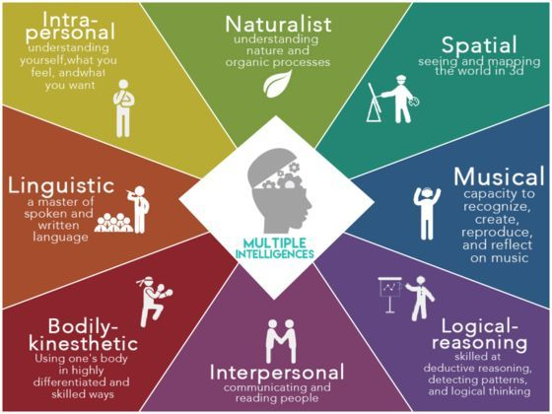
Types of Intelligence
Gardner argues in Theory of Multiple Intelligence (1984) that our culture exalts verbal and logical intelligence too much, while ignoring other forms of intelligence. It should therefore be stressed that intelligence is much more than the traditional verbal and mathematical abilities.
Intelligence (intelligentia - “insight, ability to know”; intellegere - “understand”) or mind - is a special form of interaction between subjects and objects. There are several types of intelligence that are distinguished.
It is recognised that the society of the future will be a creative society (Florida) that will be tolerant of different forms of expression.

Slide 42
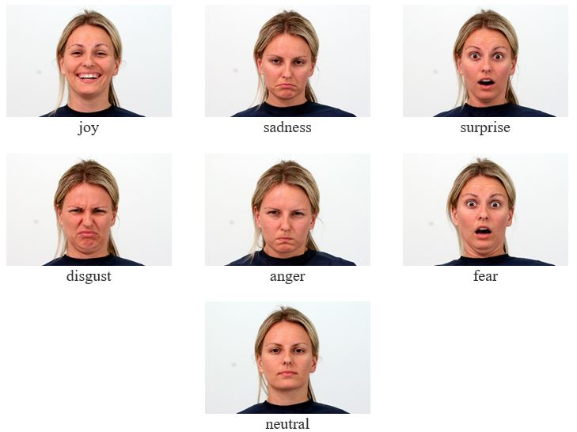
Computer Emotion Recognition

Slide 43
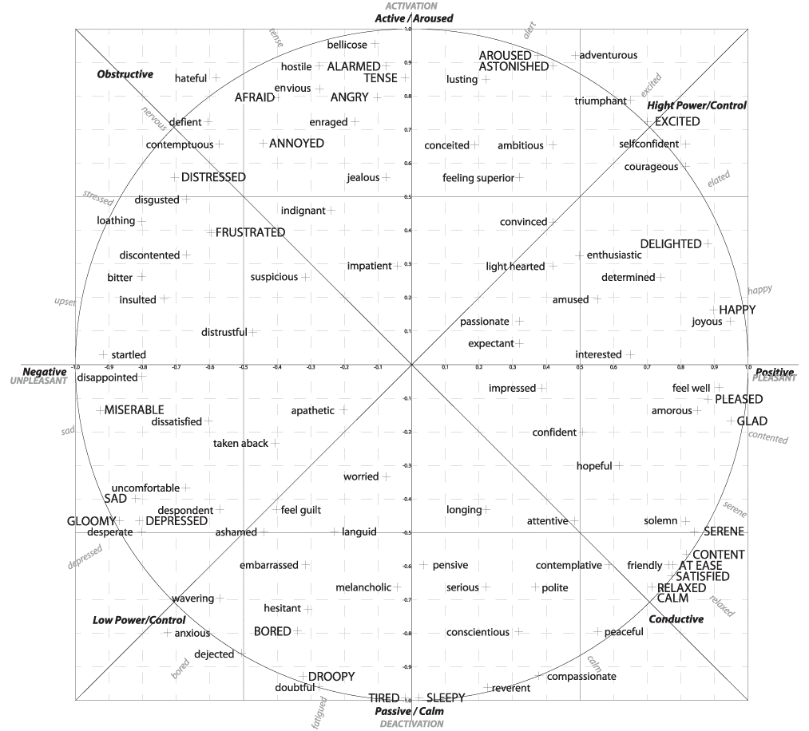
Computer Emotion Recognition
R. Karbauskaitė, L. Sakalauskas, G. Dzemyda, Kriging Predictor for Facial Emotion Recognition Using Numerical Proximities of Human Emotions, Informatica 31(2020), no. 2, 249-275, DOI 10.15388/20-INFOR419
Two-dimensional J.A., Russel emotional Activity-Positivity model, has been applied to operationalisation.

Slide 44
Wrap-up and conclusions
The discussed bridging between social sciences and humanities with computer science and OR paves the way towards the development of data-driven operationalisation for evidence-based decisions and policies, using methods and tools of structural equation modelling, game theory and multi-agent modelling.
In order to ensure that the future society is united, creative and prosperous, and its members successfully reach the highest stage of the Maslow pyramid, i.e. self-realization, part of society's efforts should focus on developing the multiple intelligence of its members.

Slide 45
The selected papers of the MSBC-2022 conference will be published in Springer Conference Proceedings Series “Communications in Computer and Information Science”:
https://link.springer.com/book/10.1007/978-3-030-29862-3
The deadline for Proceedings paper submission
is November 25, 2022.
.

Slide 46
Special Issue "Modeling and Simulation of Social-Behavioral Phenomena"
Goal: This Special Issue of Mathematics aims to highlight and explore some of the more recent theoretical and practical advances in computer modeling and simulation of social–behavioral phenomena toward efficient decision processes. Each submitted paper will be rigorously evaluated following the revision process generally applied in the Mathematics journal. This process will be based on assessing the originality, significance, technical soundness, clarity of exposition, and relevance of the submitted paper to the theme of the Special Issue.
Guest Editors: Prof. George B. Kleiner ; Prof. Vladimir V. Mazalov and Dr. Maxim A. Rybachuk
Website: https://www.mdpi.com/journal/mathematics/special_issues/7ID3SVYOG9
Deadline for manuscript submissions: 28 February 2023 (an extension can be granted, if necessary)
Author Benefits: Open Access; High visibility; Special Discounts; No Extra Charges; Thorough Peer-Review and Decisions; Coverage by Leading Indexing Services
Special Issue QR:

