Slide 1
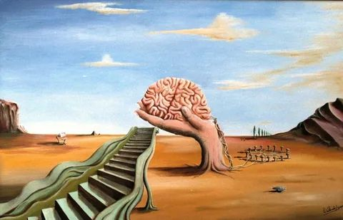
2nd International & European Conference Modelling & Simulation of Social-Behavioural Phenomena in Creative Societies Closing Session September 23, 2022
Prof. habil. dr. Leonidas Sakalauskas
Vilnius Gediminas Technical University Lithuania

Slide 2
Content
About MSBC-2022
Publications of MSBC-2022
About MSBC-20xx conferences
Mission of MSBC-20xx conferences
History and plans

Slide 3
About MSBC-2022
The 2nd International & European conference “Modelling & Simulation of Social-Behavioural Phenomena” took place on September 21-23, 2022, Vilnius, Lithuania, http://msbc.tech
During the conference, 6 invited lectures were given by well-known leading experts.
The one-channel regular program of MSBC-22 contained 9 contributed sessions, where 36 contributions were presented in total.
Finally, more than 50 participants from 9 countries took part in the conference.

Slide 4
MSBC-2022 Publications
1) the book of abstracts has been delivered during the conference
2) the selected papers of the MSBC-2022 conference will be published in Springer Conference Proceedings Series “Communications in Computer and Information Science” (eds. N. Agarwal, G. Kleiner, L. Sakalauskas):
https://link.springer.com/book/10.1007/978-3-030-29862-3
Deadline for Proceedings paper submission: November 25, 2022
3) The Special Issue “Modelling & Simulation of Social-Behavioural Phenomena” will be published in the top-rated journal “Mathematics” (CA Q1) (eds. G. Kleiner, V. Mazalov, M. Rybachuk):
https://www.mdpi.com/journal/mathematics/special_issues/7ID3SVYOG9
Deadline for manuscript submission: 28 February 2023

Slide 5
About MSBC-20xx conferences

Slide 6
MSBC-20xx conferences are biannual scientific conferences on the subject “Modelling and simulation of social-behavioural phenomena in creative societies”.
The organisational goal of MSBC-20xx is the creation of a EURO Working Group on the conference subject (several tens of members).
In order to have a EURO EC agreement for the creation of an EWG, we should meet the requirements, which are relevance to OR, originality, scientific activity (conferences, other events) and scientific production (papers, projects).
The organisation of the EURO Summer Institute (ESI) on the MSBC methodology is also a strong tool for the spread of MSBC methodology.

Slide 7
About MSBC-20xx conferences
MSBC-20xx is a three-day event, which usually takes place before the weekend in the second part of September.
The MSBC-20xx scientific program consists of plenary and regular (contributed and poster) sessions.
Plenary sessions, 1 per day, contain two academic lectures, given by well-known leading experts.
The regular sessions program consists of streams of contributed and invited sessions. One stream (channel) consists of 9 contributed or invited sessions, the latter ones usually contain 4 presentations of 25 minutes duration (20 minutes for talk + 5 minutes for questions and discussion).

Slide 8
About MSBC-20xx conferences
Publications of MSBC-20xx consist of
1) book of Abstracts;
2) volume of Proceedings in Springer Proceedings Series “Communications in Computer and Information Science” (CCIS);
3) special paper issues in top-rated journals;
4) collective monographs and books.

Slide 9
Mission of MSBC-20xx conferences

Slide 10
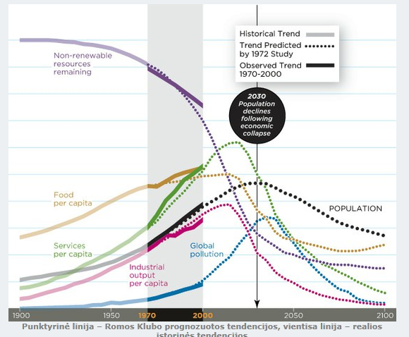
We live in a time after the peak of world development prognoses (D. Meadows “Limits of Growth”), which distinguishes by the decrease in important indicators for people.
The quality of life is forecasted to decrease, and data statistics show that the pessimistic predictions are becoming true.

Slide 11
The growing challenges of societal sustainability, social complexity, behavioural operations research, and cohesion are becoming more and more acknowledged worldwide.
However, there is a conceptual and analytical gap in understanding the driving forces behind it.
MSBC-20xx conferences pursue bridging the computer science and OR with social sciences and humanities.

Slide 12
Thorough multidisciplinary research efforts are in demand, starting from concepts and models, and ending with recommendation and decision support systems.
It is natural to assume that in the current historical time when many delicate socio-political challenges have to be dealt with once again, it is important to resort to OR to overcome those challenges.
In this regard, simple and universally acceptable assumptions behind OR need to be formulated to address the complex social-behavioural phenomena of today.
Integration of MSBC-20xx and COMPRAM methodologies is very perspective.

Slide 13
The discussed bridging between social sciences and humanities with computer science and OR paves the way towards the development of data-driven operationalisation for evidence-based decisions and policies, using methods and tools of structural equation modelling, game theory, and multi-agent modelling.
In order to ensure that the future society is united, creative and prosperous, and its members successfully reach the highest stage of the Maslow pyramid, that is, self-realisation, part of society's efforts should focus on developing the multiple intelligence of its members.

Slide 14
History and plans

Slide 15
The 1st International & Euro Mini Conference MSBC-2019 took place on September 18-20, 2019, Vilnius, Lithuania, http://www.msbc2019.mii.vu.lt
The 2nd International & European Conference MSBC-2022 took place on September 21-23, 2022, Vilnius, Lithuania, http://msbc.tech
The 3rd International Conference MSBC-2024 is planned to be held on September 18-20, 2024 (in organisation; participation preferable in person)

