Slide 1
Dynamic models of transport resources management
Alexandr Mishchenko, Oleg Kosorukov, Olga Sviridova

Slide 2
The problem of managing transport resources in a large city has become particularly acute
limited capacity of urban highways
nonlinear increase in the cost of transporting passengers and cargo in the city
increasing flow of vehicles
Modern research on transport management:
models and methods of system dynamics,
optimization theory,
regression analysis,
computer modelling
and ect...

Slide 3
The present research proposes models for managing urban passenger transport, taking into account restrictions on existing transport capacity and passenger traffic intensity.
Models are designed:
to distribute a limited fleet of buses over a finite number of routes, while minimizing the overall loss of time for transport services;
to distribute a limited fleet of buses over a finite number of routes, while minimizing the number of passengers whose transport service time exceeds the critical one

Slide 4
Statement of the problem
Two dynamic optimization models of the distribution of buses along the routes of urban passenger transport have been developed. The criterion of the fist model is the indicator of the total loss of time by passengers waiting for transport service at a given time interval. In the second model, this indicator is the number of passengers whose waiting time for transport service has exceeded a certain critical value.
The limitations in these models are as follows:
1 the total number of buses allocated to routes should not exceed the specified value
2 at least one bus must be allocated for each route
3 all passengers arriving at a fixed time interval at all stops of the routes should be
transported
Improving the quality of passenger service
Minimizing the number of passengers refusing service transportation on the specified routes

Slide 5
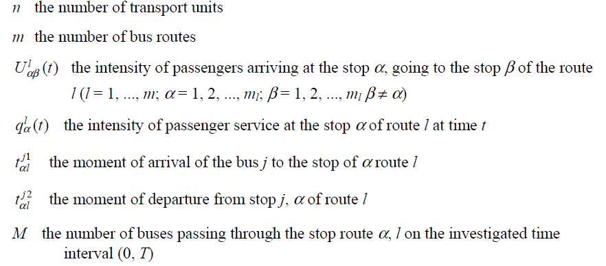
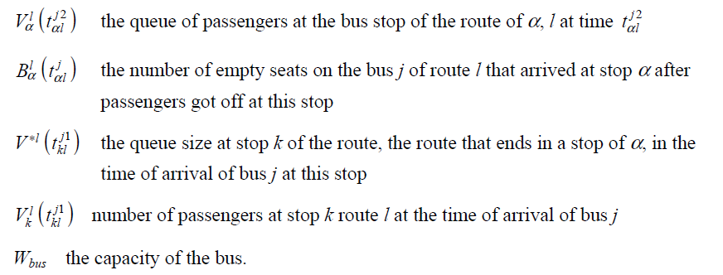
NOTATIONS

Slide 6
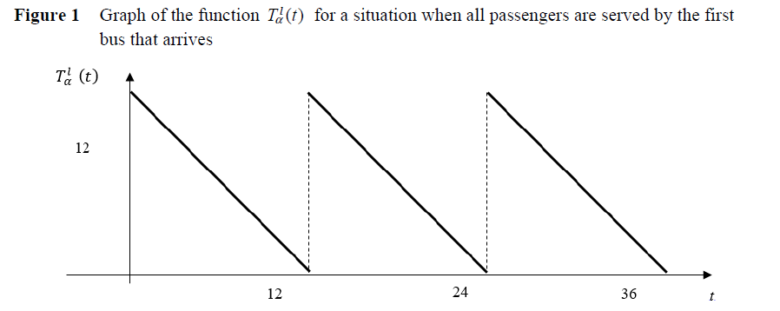
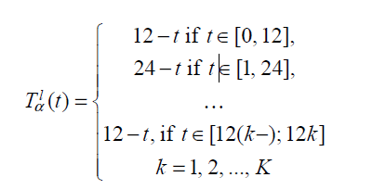
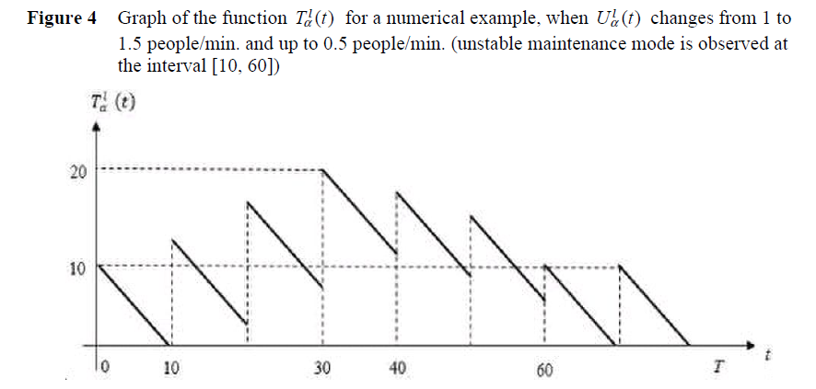
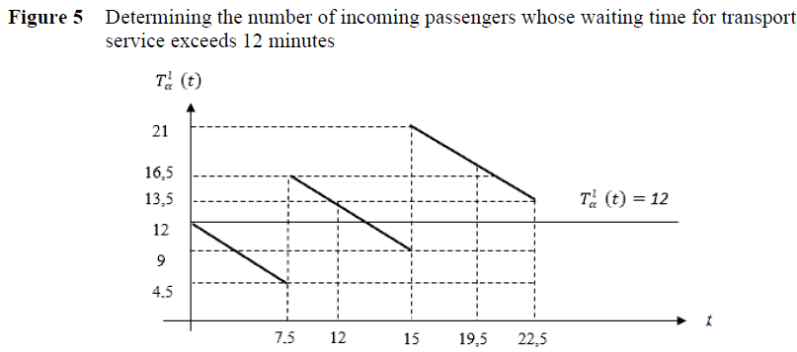
Waiting time (example) for transport service for a passenger who arrived at the stop α of route l as T_{α}^{l} (t).

Slide 7
OPTIMIZATION MODEL
Thus, the objective function (10) in the model (10)–(12) sets the total loss of time for passengers waiting for transport services at all stops at the time interval (0, T) for various permissible bus distributions along the routes specified by set A. Restriction (11) indicates that the number of all buses distributed along the routes is fixed and equal to m.
Condition (12) means that all passengers arriving at a particular stop must be transported

Slide 8
OPTIMIZATION MODEL 2
Minimizing the number of passengers whose waiting time for transport services exceeds some critical time τ_{b} (τ-boundary).
We denote by Ω(a) the set of passengers whose waiting time is more than τb when distributing buses along the routes specified by the vector a = (a1, …, am). Accordingly, through |Ω(a)| denote the number of passengers in the set Ω(a)

Slide 9
OPTIMIZATION MODEL 2
Optimization problem (13)–(15) is a nonlinear integer problem. When choosing any
distribution a ∈ A passenger service intensity is determined q_{α}^{l} (t) at every stop. Next, a
function T_{α}^{l} (t) can be formed for a final moment of time t the arrival of passengers at one
of the stops.
Given the complexity of exhaustive search of all options for distributing buses along the route on the set A, it is preferable to solve problem (13)–(15) using the so-called branch and bound method. This method allows you to discard in advance inefficient options for redistributing buses.

Slide 10
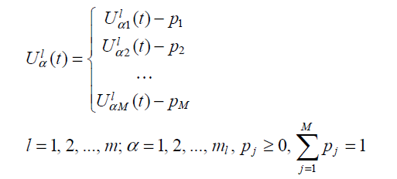
Situation where the intensity of passenger arrivals U_{α}^{l} (t) is a random function with a given discrete probability distribution:
In this case, when solving problem (13)–(15), one can use the mathematical expectation of the intensity of passenger arrivals:

Slide 11
At the same time, taking into account the congestion of urban transport routes, especially during peak hours, the bus schedule on the routes cannot be maintained exactly. Therefore, the intensity of passenger service q_{α}^{l} (t) is also stochastic.
Further, problem (13)–(15) can be solved provided that the passenger arrival rates are set as U_{α}^{l} (t) and passenger service intensity – how q_{α}^{l} (t) choosing a distribution of buses
along routes that would minimize the functional (13).

Slide 12
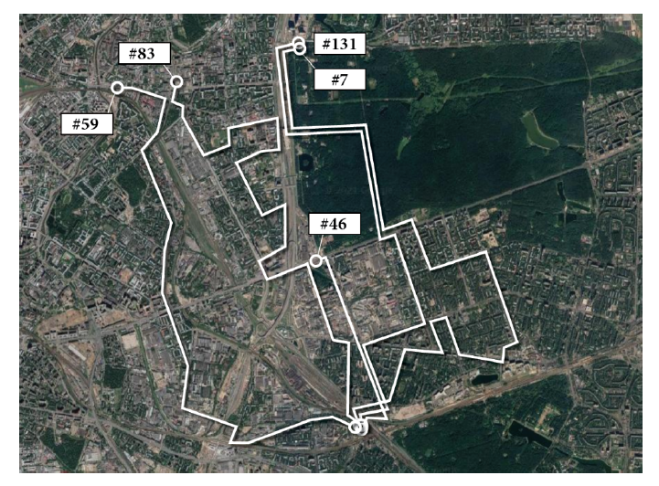
We have considered numerical examples of the use of models. Calculations are performed using the MS Excel program.
Consider five real bus routes serving the population of one of the districts of Moscow. In total, these bus routes serve about 100 buses per day. On these routes, an average of 20% of the population of the region is served per day, that is, 253,040 people (including return trips). Route maps and passenger flow parameters on some routes are shown in the figure. Assume that 100 buses need to be distributed along these routes so that the number
passengers whose service waiting time exceeds τb is minimal. We considered the models in turn and solved the problems within these models. In this case, the condition is satisfied that the number of routes is less than the number of cars (n > l).
These models can be used not only for bus transport, but also on the metro, tram,
trolleybus, etc.

Slide 13
Methods for solving optimization problems and a more detailed description of numerical examples can be found in:
Aleksandr Mishchenko, Oleg Kosorukov, Olga Sviridova DYNAMIC MODELS OF TRANSPORT RESOURCES MANAGEMENT, International Journal of Logistics Systems and Management, 2021, DOI: 10.1504/IJLSM.2021.10041729

Slide 14
Thank you for your attention

