Slide 1
Research on the prediction of highly cited papers based on PCA-BPNN
Changxu Duan
Report Date: 2022.9.23
Notes:
知行微思工作室

Slide 2
01
Research background and Problem
02
Data and Methods
CONTENTS
03
Experiment and Result Analysis
04
Conclusion
Notes:
知行微思工作室

Slide 3
Part.1
Research background and Problem

Slide 4
Research background and Problem
Data and Methods
Experiment and Result Analysis
Conclusion
1.1 Background
01
Scientific papers are the basic unit of scientometric research.Faced with the massive amount of papers, scholars need to spend a lot of cost in finding high impact papers. Academics often use the frequency of citation as an evaluation indicator of the impact of academic papers. However, while the citation frequency index is widely used, it can only measure a paper's current and past scientific impact. In many cases, people want to go beyond this to predict future scientific impact; therefore, we need to go beyond the current citation date of papers and forecast its future citations to reflect its future scientific implications as well .
02
Limitations of existing studies：
（1）Only using a single category or fewer prediction features cannot achieve ideal prediction results.；
（2） Using prediction features with higher dimensions will still face the problems of feature redundancy and irrelevance, which may lead to long model training time, dimensional disaster, model overfitting, and generalization decline.
03
In view of these problems and limitations, this paper:
（1）Construct an efficient prediction feature space from several aspects.
（2）Based on principal component analysis (PCA), feature selection and dimensionality reduction are performed on prediction features. Also, combined with BP neural network (BPNN), a highly cited paper recognition model (PCA-BPNN) is proposed based on the characteristics in the early publication stage.

Slide 5
Research background and Problem
Data and Methods
Experiment and Result Analysis
Conclusion
1.2 Problem Definition
This paper defines the prediction of paper influence as a classification prediction problem. A classification model is then constructed by analyzing and collecting characteristic factors related to the citation frequency of papers to identify high-level papers in the early stage of publication.
Since the citation frequency of a paper five years after publication is a crucial reflection to indicate the quality of papers, existing studies on paper influence the prediction mostly choose to use a five-year citation window to measure and predict the quality and impact of papers.
Meanwhile, this paper defines highly cited papers based on the “Pareto principle,” e.g., papers with a cumulative citation frequency of 80% (in this paper, papers with a citation frequency of more than 5) are defined as highly cited papers.
Notes:
知行微思工作室

Slide 6
Part.2
Data and Methods

Slide 7
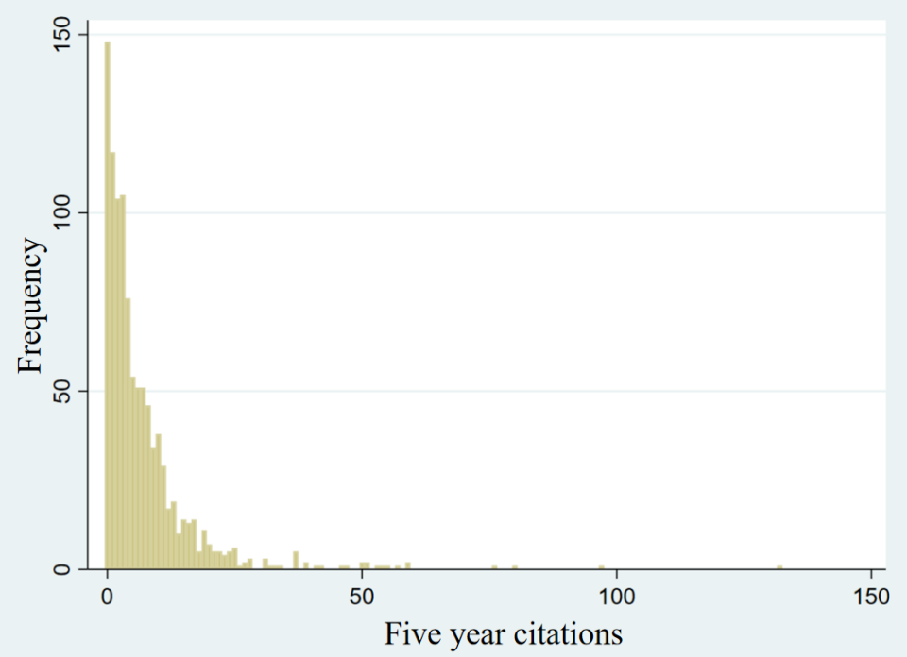
Research background and Problem
Data and Methods
Experiment and Result Analysis
Conclusion
2.1 Data Sources and Analysis
The basic data used in this paper are 1025 articles published in 20 journals under Information Science and Library Science in JCR in 2007.
This paper makes statistics on the citation frequency of papers in the dataset five years after publication and uses the citation frequency and count as the Y-axis and X-axis, as shown in Figure 1.
It can be seen from Figure 1 that the citation frequency of papers five years after publication is a discrete integer greater than or equal to 0, showing prominent long-tail characteristics. A large number of articles are cited in a frequency ranging from 0 to 5.
Figure 1 Distribution of citation frequency

Slide 8
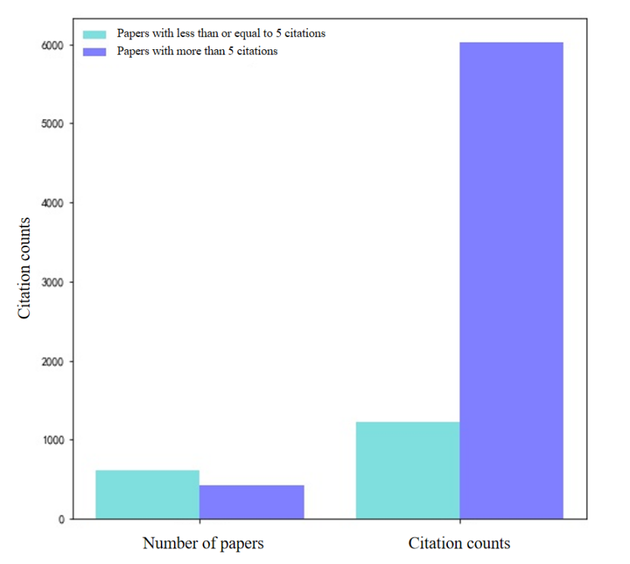
Research background and Problem
Data and Methods
Experiment and Result Analysis
Conclusion
2.1 Data Sources and Analysis
This study further compares papers with citations less than or equal to 5 and those greater than 5, as shown in Figure 2. Although the number of papers with a citation frequency less than or equal to 5 accounts for about 60%, their cumulative citation frequency only accounts for 16.7%, which is a considerable gap. More than 80% of cumulative citation frequency is completed by 40% of the literature. It can be considered that the remaining 60% of literature has a minimal contribution to cumulative citation frequency in a low-cited state. This indicates that the distribution of citation frequency of papers is basically in line with the “Pareto principle,” and it is appropriate to define highly cited papers on this basis.
Figure 2 Comparison of papers with citations less than or equal to 5 and those greater than 5

Slide 9
Research background and Problem
Data and Methods
Experiment and Result Analysis
Conclusion
Number of authors | X1
H index of the first author before publishing this paper | X2
Total number of papers published by the first author before publishing this paper | X3
Total citation frequency of the first author before publishing this paper | X4
Average citation frequency of the first author before publishing this paper | X5
Highest h-index of all authors before publishing this paper | X6
The highest number of papers published by all authors before publishing this paper | X7
Highest total citation frequency of all authors before publishing this paper | X8
Highest average citation frequency of all authors before publishing this paper | X9
2.2 Prediction Features
Author Characteristics
Features
Number of literature | X10
Year of first citation | X11
Citation frequency in the first two years of publication | X12
Number of citing countries in the first two years of publication | X13
Type of citing literature in the first two years of publication | X14
Number of cited journals in the first two years of publication | X15
Number of citing disciplines in the first two years of publication | X16
Paper characteristics
Total citation frequency of journals | X17
Journal impact factors | X18
5-year impact factors of journals | X19
Immediacy index of journals | X20
Published article volume of journals | X21
Cited half-life of journals | X22
Value of characteristic factors | X23
Value of paper impact | X24
Journal characteristics

Slide 10
Research background and Problem
Data and Methods
Experiment and Result Analysis
Conclusion
2.3 Data Labeling and Standardization
Data Labeling and Standardization 1) Data labeling: Based on the problem definition of this paper and the above analysis, if the citation frequency of papers five years after publication is greater than 5, it is defined as highly cited papers, marked as positive type, and the classification value Yc is represented by 1; if the citation frequency is less than or equal to 5, it is considered as non-highly cited papers, marked as negative type, and the classification value Yc is represented by 0. 2) Normalization of original samples: Since the data size of 24 indicators is different, and the data unit is also different, it is necessary to normalize the original data to eliminate the influence of dimension and absolute value. The normalization formula is:
(1)
(1) In the formula: X* is the original data of an indicator; X*max and X*min are the maximum and minimum values ​​of an indicator; X is the normalized data of an indicator, X∈[0,1].

Slide 11
Research background and Problem
Data and Methods
Experiment and Result Analysis
Conclusion
2.4 Prediction Models
Principal Component Analysis
Principal component analysis (PCA) is a linear descending dimension method, and its principle is: firstly, constructing a linearly independent covariance matrix between features based on the original data, then solving the eigenvalue ​​of the covariance matrix, and then constructing the optimal projection matrix based on several large eigenvalues ​​and corresponding eigenvectors. After the above transformation, the original data can be mapped to the new feature space according to the projection matrix to complete dimensionality reduction. Through the analysis of the influencing factors of citation frequency, this paper selects three indicators, including papers, journals, and authors, as eigenvectors. However, the dimension of selected data features is 24, indicating a certain degree of redundancy in the data. Hence, to reduce the feature dimension, PCA is used to process dimensionality reduction, extracting the principal components of these 24 indicators as the input vector of the BP neural network.
In order to ensure that the extracted principal component can represent most of the information reflected by the original data, this paper selects the principal component vector required for greater than 90% of the cumulative variance contribution rate.

Slide 12
Research background and Problem
Data and Methods
Experiment and Result Analysis
Conclusion
2.4 Prediction Models
Principal Component Analysis
It can be seen from Table 2 that the cumulative contribution rate of the variance of the first seven factors reaches 90%, recorded as F1, F2, F3, F4, F5, F6, and F7. Seven eigenvectors composed of 24 eigenvectors are used as the new eigenvariables, and the composition coefficient of each factor is shown in Table 3.
Table 2 Using principal components to explain the total variance of original variables
Component | Principal component1 | Principal component2 | Principal component3 | Principal component4 | Principal component5 | Principal component6 | Principal component7
Eigenvalue | 2.9339 | 1.7882 | 1.2227 | 1.2024 | 1.1543 | 1.0951 | 1.0904
Contribution rate% | 45.6 | 14.3 | 11.1 | 7.2 | 5.5 | 3.5 | 2.9
Cumulative contribution rate % | 45.6 | 59.9 | 71.0 | 78.2 | 83.7 | 87.2 | 90.1

Slide 13
Research background and Problem
Data and Methods
Experiment and Result Analysis
Conclusion
2.4 Prediction Models
Principal Component Analysis
Table 3 Factor component coefficient
Component factor | F1 | F2 | F3 | F4 | F5 | F6 | F7
X1 | -0.0289 | -0.0921 | 0.3514 | 0.1067 | -0.1677 | 0.0757 | -0.1215
X2 | -0.4563 | 0.6826 | 0.0102 | 0.0938 | -0.0416 | 0.0005 | -0.1520
X3 | 0.0076 | 0.0138 | 0.4277 | 0.0042 | 0.4757 | -0.2216 | -0.2411
X4 | 0.0191 | 0.0279 | -0.0656 | -0.4025 | -0.3567 | -0.1482 | -0.1243
X5 | 1.1543 | -0.0787 | 0.2262 | 0.6326 | -0.1003 | -0.2234 | 0.0460
X12 | -0.0556 | 0.0578 | -0.0693 | -0.1305 | 0.5532 | -0.0604 | 0.1441
X13 | 1.0904 | -0.0577 | -0.4474 | 0.1955 | 0.1337 | -0.4921 | -0.2905
... | ... | ... | ... | ... | ... | ... | ...
X23 | -0.0172 | 0.0491 | 0.0261 | 0.2217 | 0.0393 | 0.2089 | 0.1625
X24 | -0.5661 | -0.0718 | -0.0268 | -0.0461 | 0.0134 | 0.0230 | -0.0091

Slide 14
Research background and Problem
Data and Methods
Experiment and Result Analysis
Conclusion
2.4 Prediction Models
PCA-BPNN prediction model
The number of network layers is determined according to the comparison of the final prediction effect for the influence of the number of hidden layers, and this paper adopts a double-hidden network structure, including an input layer, two hidden layers, and an output layer. Generally, the best scenario is that the selection of the number of nodes in the input layer and output layer is with irrelevant input data. According to the calculation, there are 7 feature vectors obtained after the principal component analysis of 24 related factors, and they are not correlated with each other. Therefore, the number of neurons in the input layer is determined as 7. In this paper, both low-cited and highly cited papers need to be predicted, that is, a binary classification problem. The highly cited papers are represented by 1, while low cited papers are represented by 0. In this way, the output variable ranges from 0 to 1, so the number of neurons in the output layer is 1.
There is currently no accurate calculation method for the selection of the number of neurons in the hidden layer. In this paper, the optimal range of the number of neurons in the hidden layer is roughly determined according to the empirical formula.

Slide 15
Research background and Problem
Data and Methods
Experiment and Result Analysis
Conclusion
2.4 Prediction Models
PCA-BPNN prediction model
The number of network layers is determined according to the comparison of the final prediction effect for the influence of the number of hidden layers, and this paper adopts a double-hidden network structure, including an input layer, two hidden layers, and an output layer. Generally, the best scenario is that the selection of the number of nodes in the input layer and output layer is with irrelevant input data. According to the calculation, there are 7 feature vectors obtained after the principal component analysis of 24 related factors, and they are not correlated with each other. Therefore, the number of neurons in the input layer is determined as 7. In this paper, both low-cited and highly cited papers need to be predicted, that is, a binary classification problem. The highly cited papers are represented by 1, while low cited papers are represented by 0. In this way, the output variable ranges from 0 to 1, so the number of neurons in the output layer is 1.
There is currently no accurate calculation method for the selection of the number of neurons in the hidden layer. In this paper, the optimal range of the number of neurons in the hidden layer is roughly determined according to the empirical formula.

Slide 16
背景和意义
研究现状
研究思路
研究难点
进度安排
2.4 Prediction Models
PCA-BPNN prediction model
Table 5 Model parameter settings
N | Training parameter | Parameter value
1 | Activation function in the hidden layer | ReLU
2 | Activation function in the output layer | Sigmoid
3 | Optimizer | Adam
4 | Loss function | binary_crossentropy
5 | Evaluation function | binary_accuracy
6 | Learning rate | lr = 0.001
7 | Maximum number of training | epochs = 2000

Slide 17
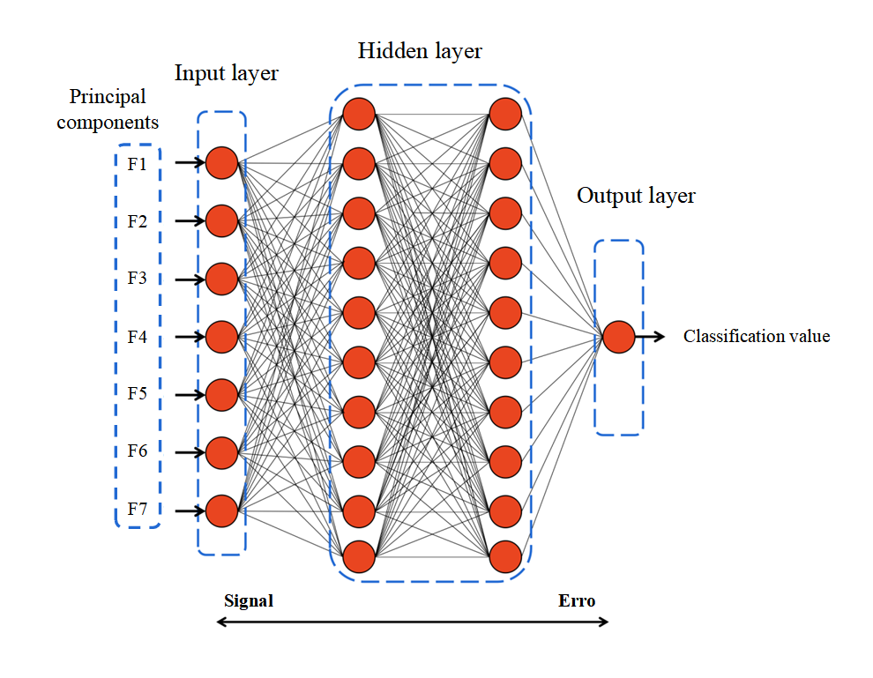
Research background and Problem
Data and Methods
Experiment and Result Analysis
Conclusion
2.4 Prediction Models
PCA-BPNN prediction model
Figure 3 PCA-BPNN structure

Slide 18
Part.3
Experiment and Result Analysis

Slide 19
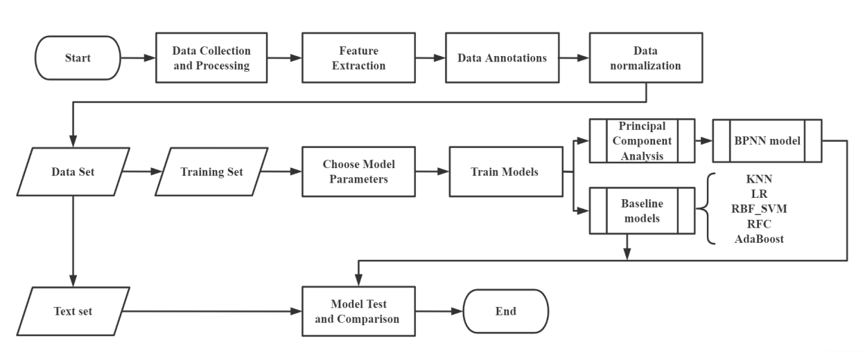
Research background and Problem
Data and Methods
Experiment and Result Analysis
Conclusion
3.1 Experimental Process
This paper uses the Python3.7 version for programming and completes data processing, drawing, and modeling in the Anaconda environment. In addition to the PCA-BPNN model, other models are also added for comparison, including the K-nearest neighbor model (KNN), logistic regression model (LR), support vector machine model (SVM), random forest model (RFC), and AdaBoost model.
The experimental process includes data preprocessing, feature extraction, modeling, parameter determination, model evaluation, etc. The specific process is shown in Figure 4.Due to the limited size of the dataset used in this paper, the training set and the test set are divided based on the 9:1 principle to comprehensively utilize the data.
Figure 4 Experimental flow chart
Notes:
知行微思工作室

Slide 20
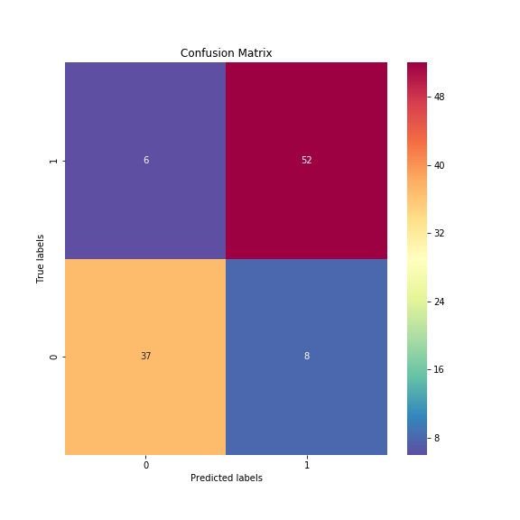
Research background and Problem
Data and Methods
Experiment and Result Analysis
Conclusion
3.2 Experimental Result
The confusion matrix is obtained, as shown in Figure 5.
It can be seen from the Figure 5 that among the 103 test samples, the number that both the actual value and predicted value belong to the positive class (TP) is 52; the number that the actual value belongs to the positive class while the predicted value belongs to the negative class (FN) is 6; the number that both the actual value and predicted value belong to the negative class (TN) is 37; the number that the actual value belongs to the negative class while the predicted value belongs to the positive class (FP) is 8. The false positive rate (FPR) is calculated to be 0.186, and the true positive rate (TPR) is 0.867.
Figure 5 Confusion matrix in the test set
Notes:
知行微思工作室

Slide 21
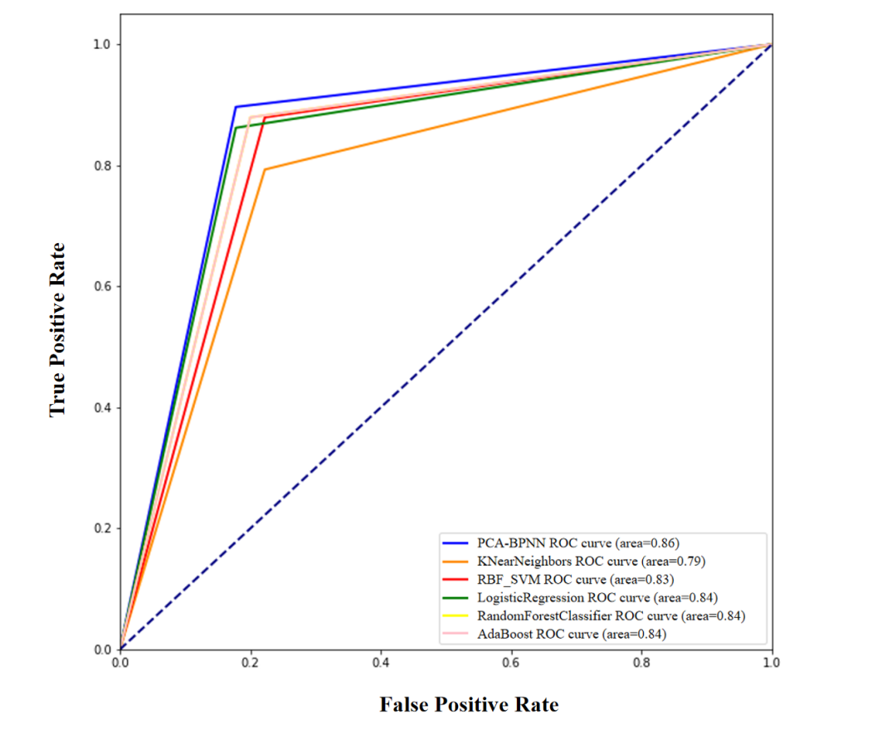
Research background and Problem
Data and Methods
Experiment and Result Analysis
Conclusion
3.2 Experimental Result
Then, the ROC curve of each model is drawn, taking TPR as the vertical axis and FPR as the horizontal axis, as shown in Figure 6.
The larger the area under the ROC curve (AUC), the better the performance of the classification model. The classification model with an AUC value above 0.8 indicates good performance, and the classification model with an AUC value above 0.9 indicates excellent performance. It can be seen from Figure 6 that the AUC value of the neural network model constructed in this paper is significantly higher than that of other classification models, close to 0.9, indicating that the model proposed in this paper has an excellent performance in classification prediction.
Figure 6 ROC curve of each model
Notes:
知行微思工作室

Slide 22
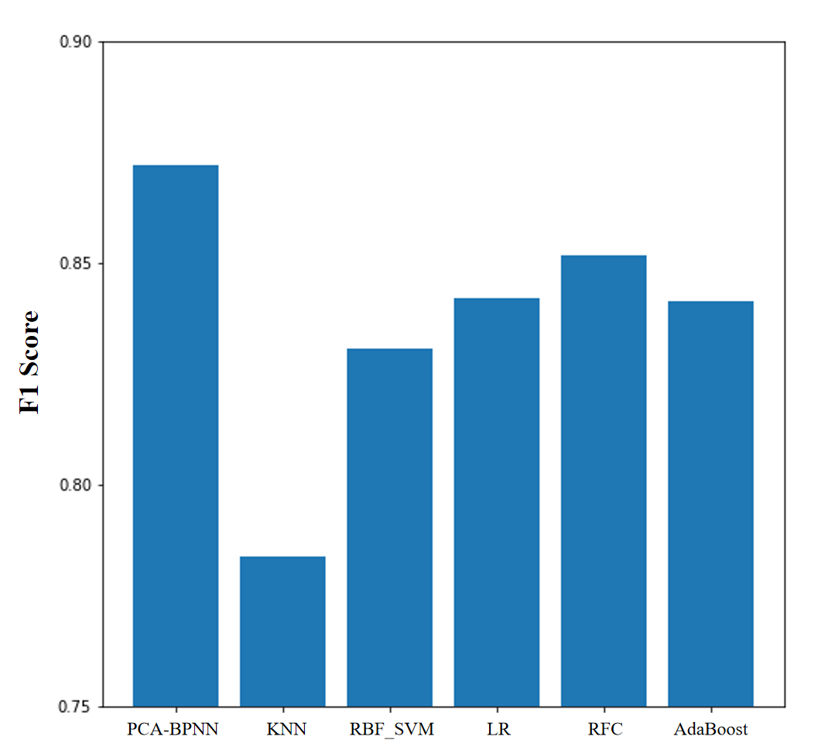
Research background and Problem
Data and Methods
Experiment and Result Analysis
Conclusion
3.2 Experimental Result
The F1 value of each model is then compared, as shown in Figure 7. It can be seen from Figure 7 that the F1 value of the PCA-BPNN model constructed in this paper is significantly higher than that of other classification models, close to 0.9, indicating excellent performance.
Meanwhile, misclassification items are observed, most of which are concentrated in the citation frequency between 4 and 7, showing that the classification model has low accuracy in terms of the classification category with the citation frequency between 4 and 9. After analysis, the reason for this phenomenon is that papers with a citation frequency between 4 and 9 are near the classification threshold. For example, papers with a citation frequency of 5 may not be significantly different from those with a citation frequency of 6. Such papers have similar characteristics in all aspects but are manually divided into two completely separate categories. In this way, the classification model based on feature learning cannot effectively learn category features during the training. Also, performing effective classification when predicting cases close to the classification boundary is complex.
Figure 7 F1 value of each model
Notes:
知行微思工作室

Slide 23
Part.4
Conclusion

Slide 24
Research background and Problem
Data and Methods
Experiment and Result Analysis
Conclusion
4.1 Contributions
The contributions of this paper are as follows: (1) the problem of predicting the influence of scientific literature is defined as a binary classification problem to realize the prediction and identification of highly cited papers in the early stage of publication; (2) the influencing factors are summarized and classified, obtaining three types of influencing factors: authors, journals and papers. Also, according to the collected data distribution, the threshold of highly cited papers is determined combined with the “Pareto principle”; (3) the PCA is used for feature extraction, and the PCA-BNNN highly cited paper prediction model is constructed combined with BP neural network, achieving good results. This paper can help researchers predict high-impact papers in the early stage of publication, thus providing a basis for evaluating and screening the massive scientific literature in their own research fields.
Notes:
知行微思工作室

Slide 25
Research background and Problem
Data and Methods
Experiment and Result Analysis
Conclusion
4.2 Limitations and Future Work
However, this paper also has the following limitations: (1) due to limited time, the dataset collected in this paper is small and only contains one field of discipline, which may lead to limited applicability and persuasiveness of the constructed model; (2) the determination of the threshold of high and low citation frequency is still vague, and more effective methods are needed for the classification of papers near the threshold; (3) in addition to the three influencing factors proposed in this paper, there are many other factors affecting the citation frequency of papers, such as webometrics, number of users of literature management software, social bookmarking, reprint/comment, etc.
In future studies, data sets covering more disciplines will be used so as to obtain more accurate classification standards. Also, studies will extract more factors that may affect the citation of papers to develop a relatively complete framework for predicting paper citations.
Notes:
知行微思工作室

Slide 26
Thanks for listening
Notes:
知行微思工作室

